Slide 1





AMAZON
20
24
SALES REPORT
presented by
SNEHA YADAV

Slide 2



OBJECTIVE
THE MAJOR AIM OF THIS PROJECT IS TO GAIN INSIGHT INTO THE SALES DATA OF AMAZON TO UNDERSTAND THE DIFFERENT FACTORS THAT AFFECT SALES OF THE
DIFFERENT BRANCHES.

Slide 3

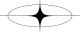
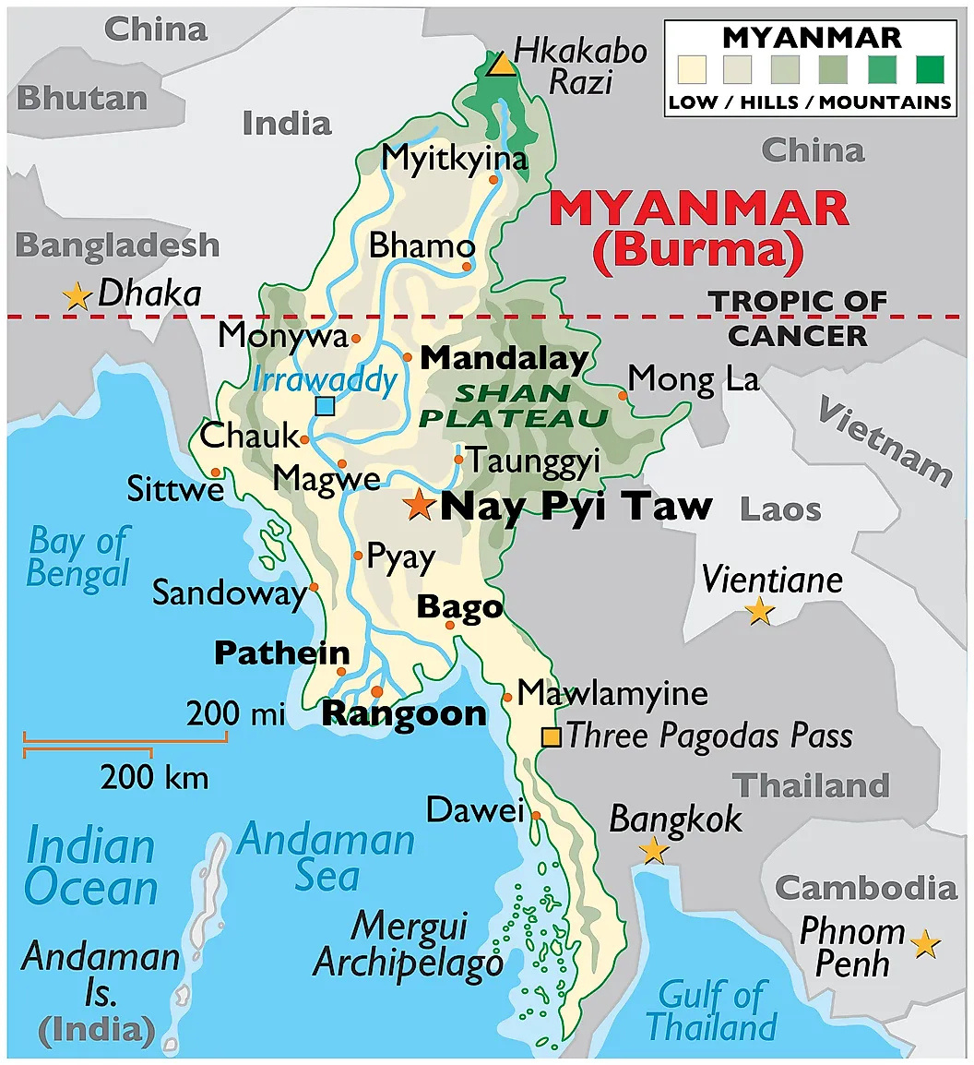

OVERVIEW OF AMAZON DATA
The dataset contains sales transactions from three different branches of Amazon Mandalay, Yangon and Naypyitaw. The data contains 17 columns and 1000 rows
( After feature engineering number of rows will be 1000 and number columns will be 20)

Slide 4
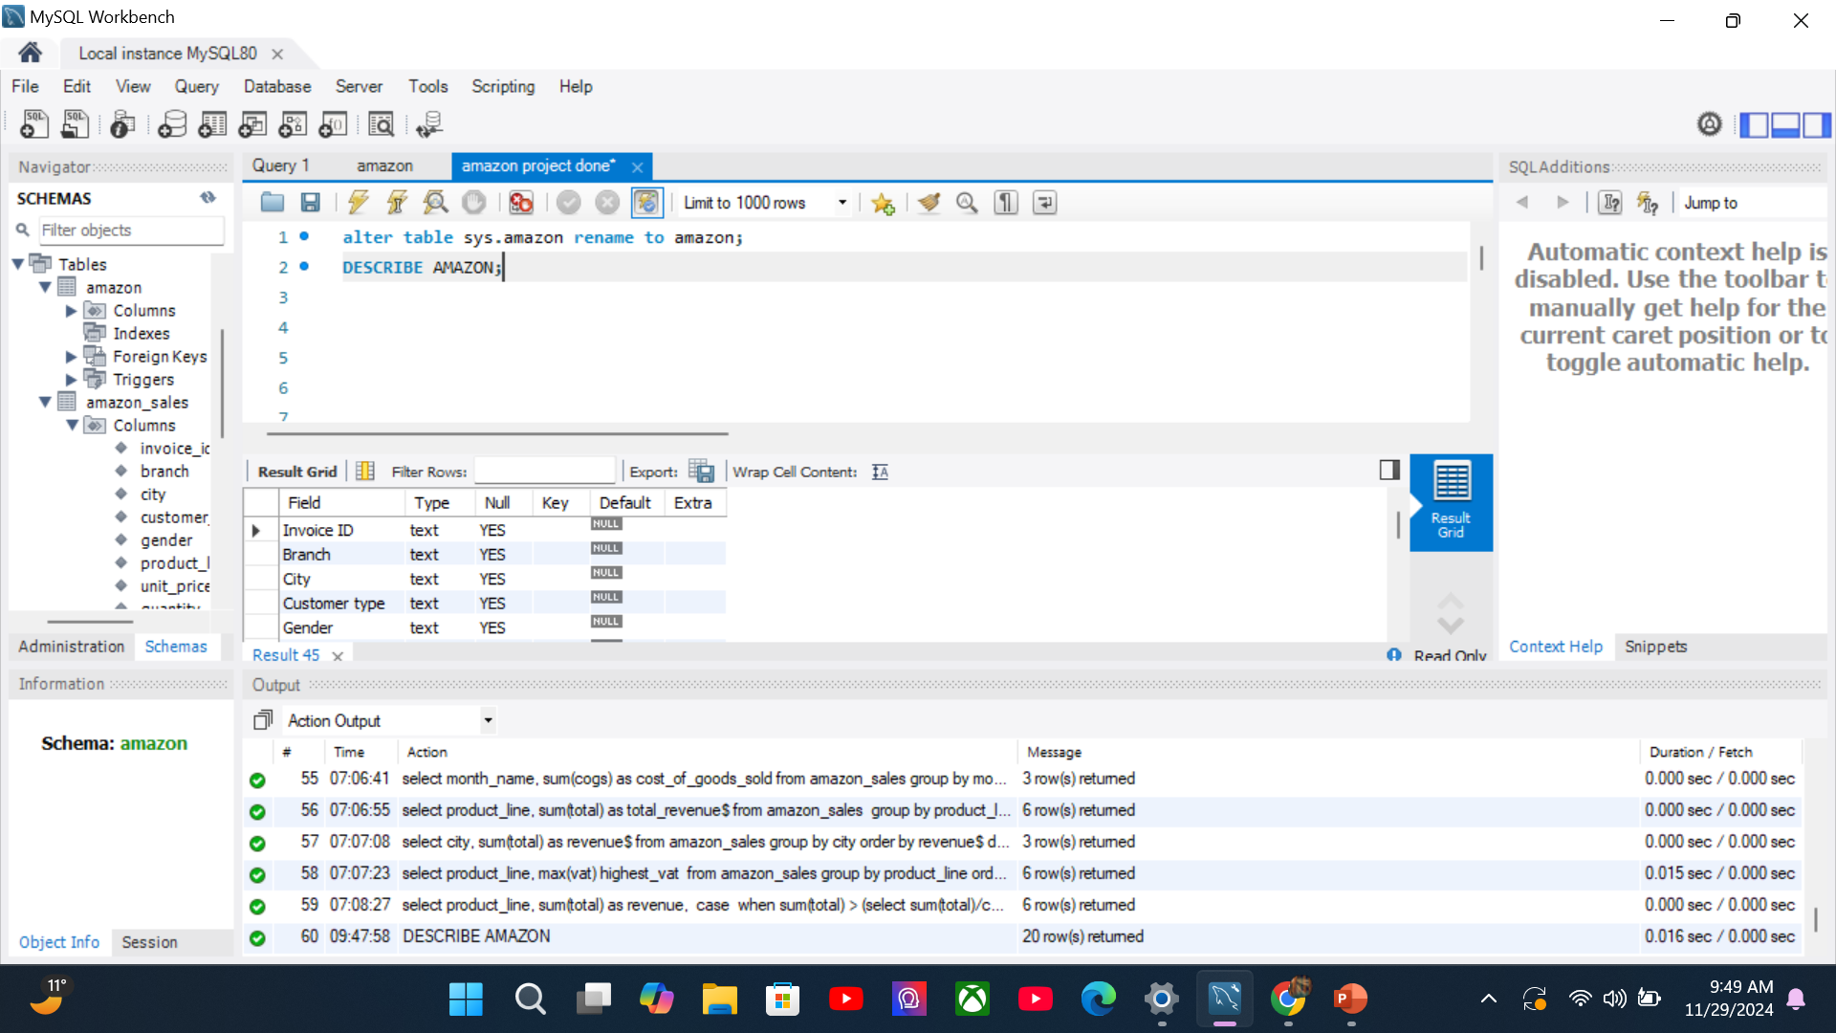
DATA WRANGLING
CREATE A DATABASE NAMED AMAZON IN MYSQL.
2. IMPORTING DATA IN THE FORM OF A TABLE IN AMAZON DATABASE.
AFTER COMPLETION OF STEP 1 AND STEP 2 WE CAN START WRITING QUERIES, IN PICTURE YOU CAN SEE (DESCRIBE AMAZON;).

Slide 5

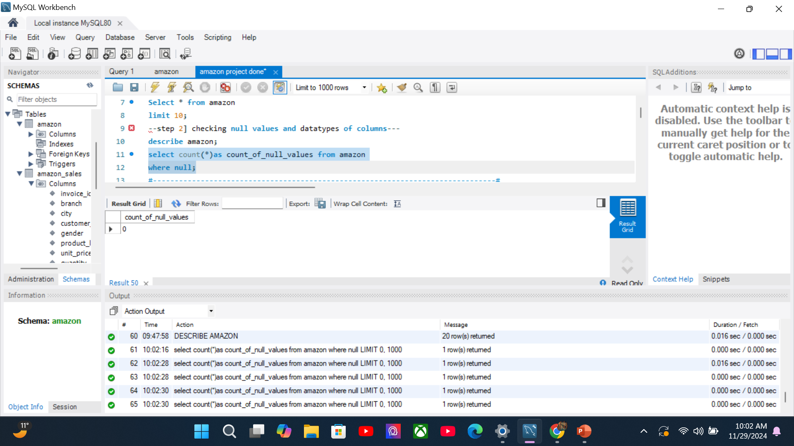
CHECKING NULL VALUES AND DATA TYPE.
There are no null values in our database .

Slide 6
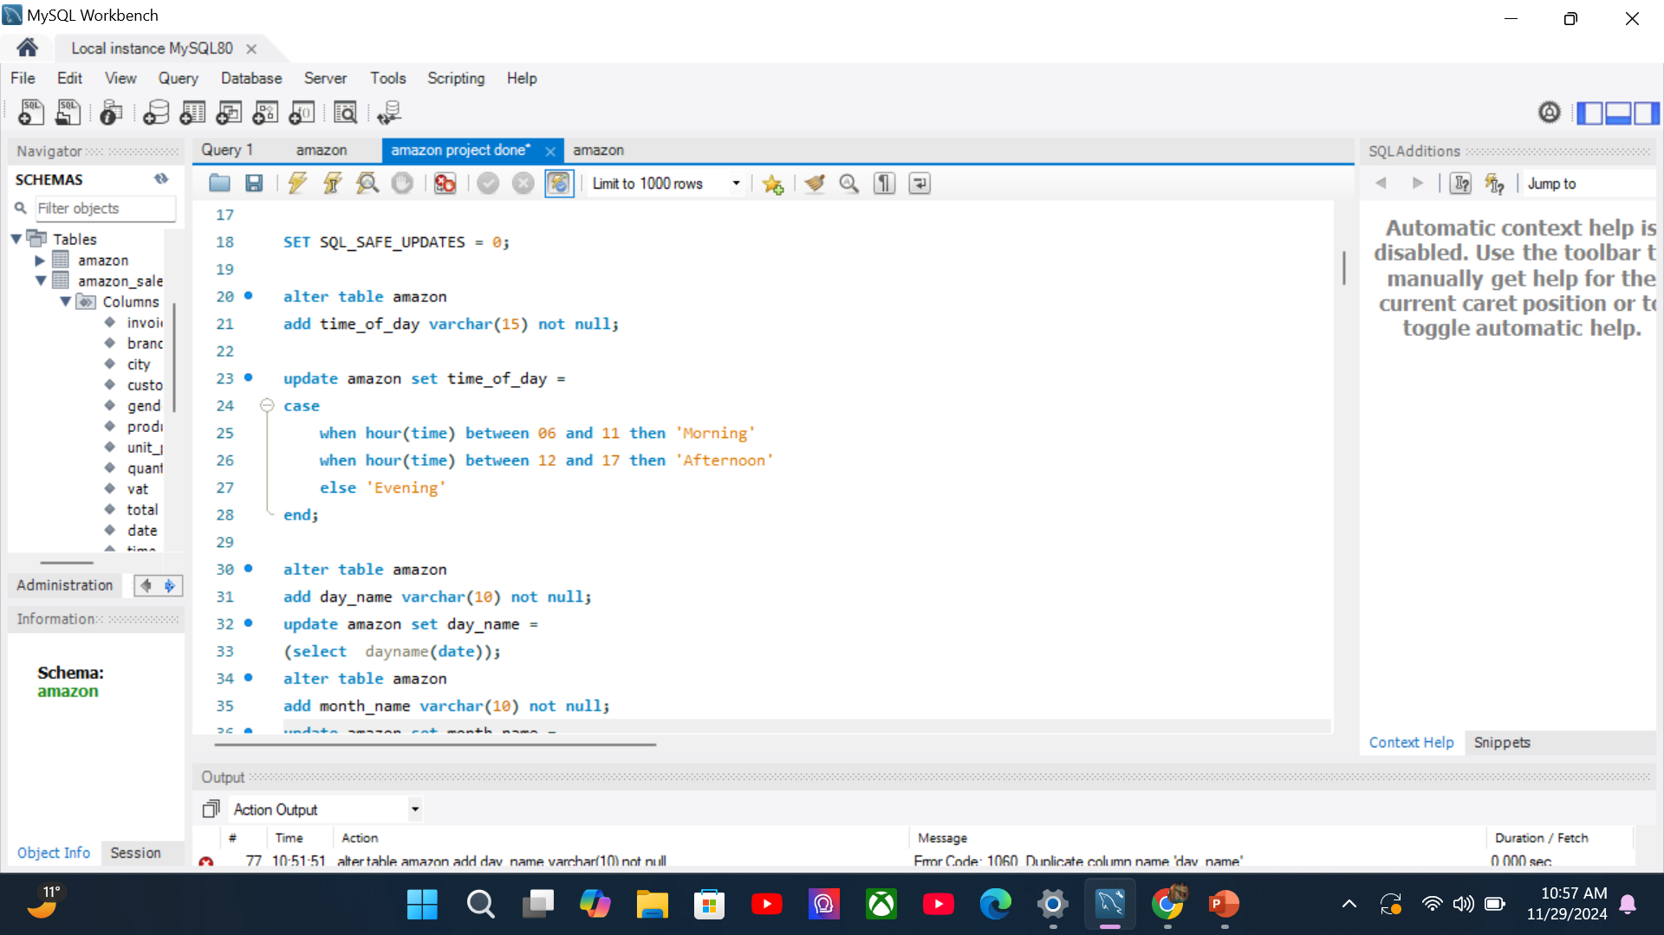
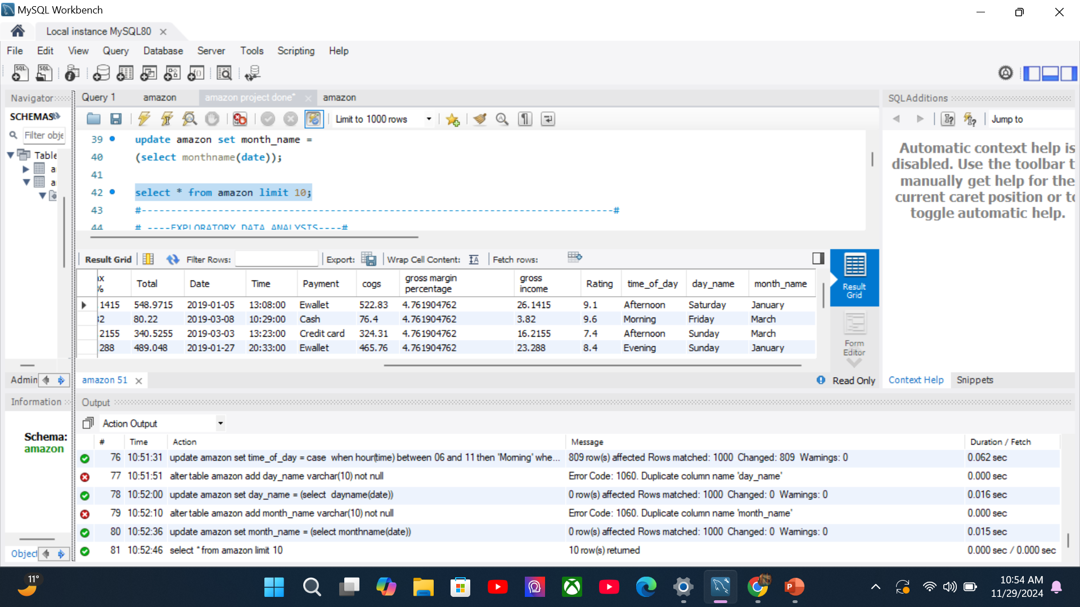
FEATURE
ENGINEERING
IN FEATURE ENGINEERING WE ARE CREATING SOME NEW COLUMNS TO EXTRACT DATA FROM DATE AND TIME COLUMN.
THIS WILL HELP US TO ANALYSE THE DATA IN TIME FORMAT AND DAY FORMAT MORE SPECIFICALLY.
FOR EXAMPLE:-TIME_OF_DAY (MORNING, AFTERNOON, EVENING)
DAY_ OF_ WEEK (MONDAY TO SUNDAY)

Slide 7

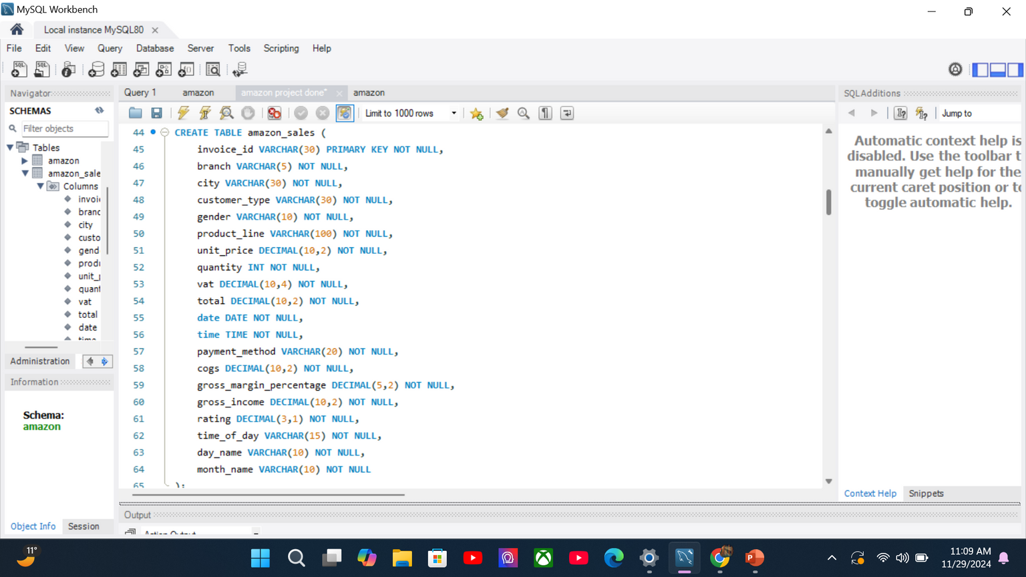
EXPLORATORY DATA ANALYSIS
CREATING NEW TABLE NAMED AMAZON SALES BY ADDING CORRECT COLUMN NAME, DATATYPE, CONSTRAINTS WHILE COPYING VALUES FROM DEMO TABLE AMAZON.

Slide 8
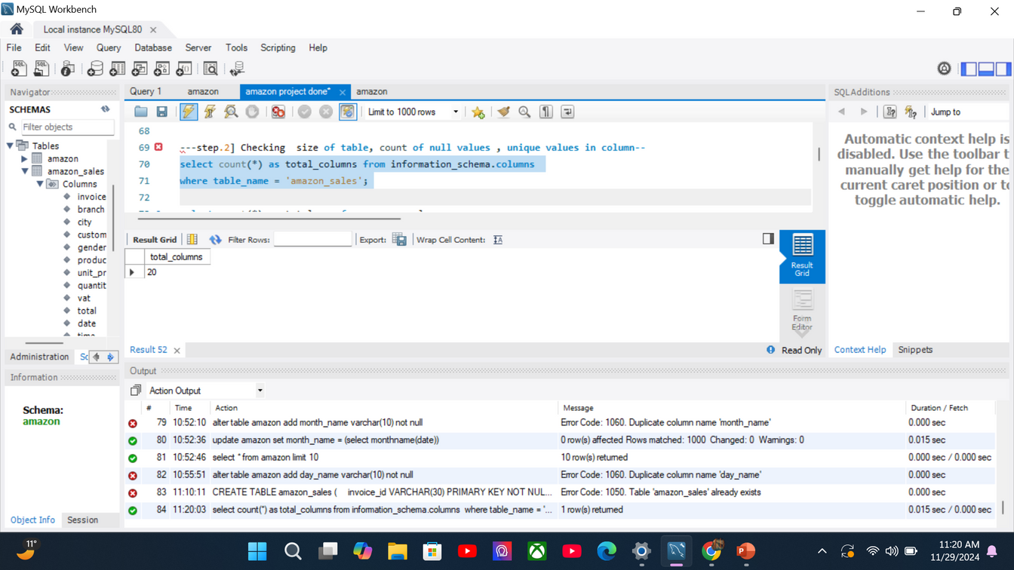
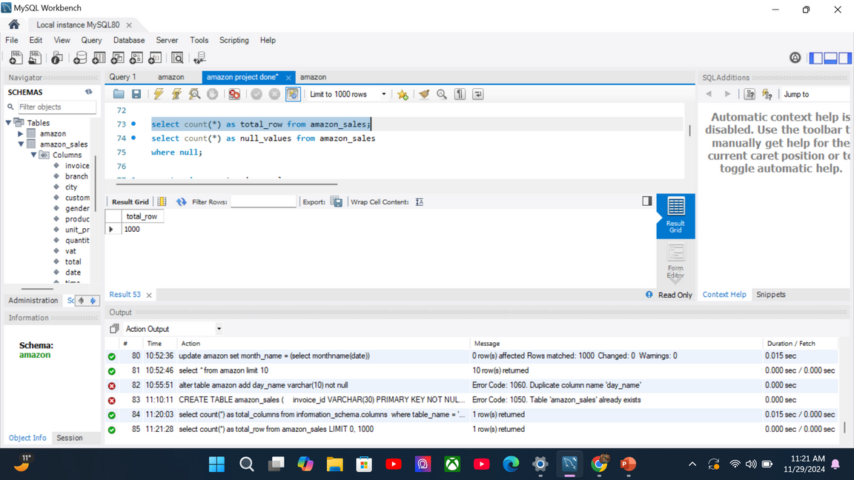
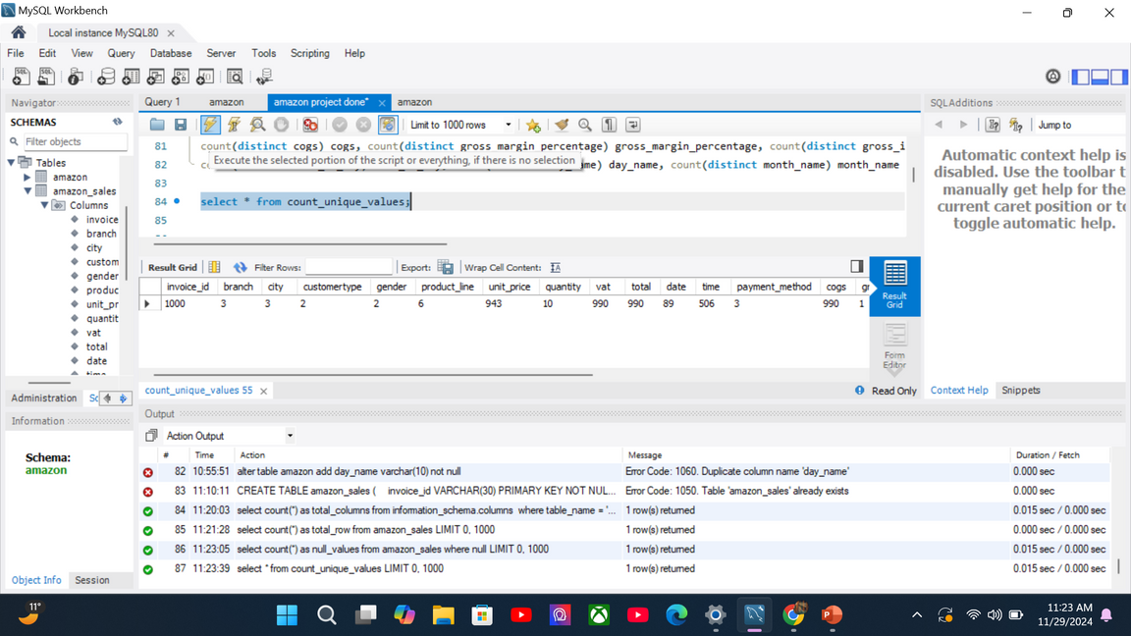
CHECKING SIZE OF TABLE, COUNT OF NULL VALUES , UNIQUE VALUES
TOTAL COLUMNS
TOTAL ROWS
UNIQUE VALUES
↓
↓
↓

Slide 9


Checking the unique values in each categorical column. There are 10 categorical columns.
1.) INVOICE_ID
2.) branch
3.) city
4.) customer_type
5.) gender
6.)product_line
7.)payment_method
8.)time_of_day
9.)day_name
10.)month_name

Slide 10
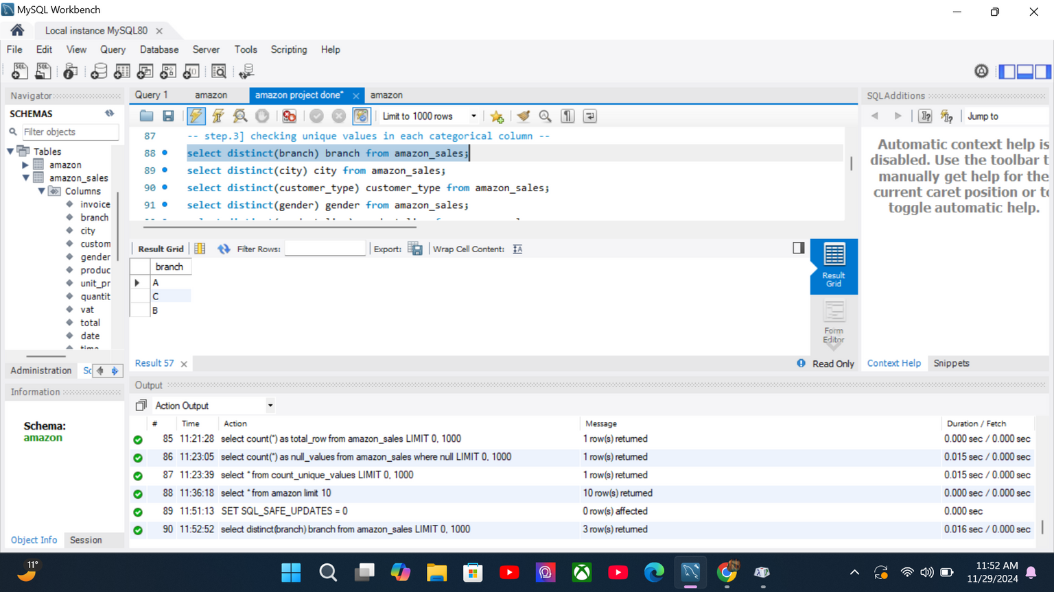
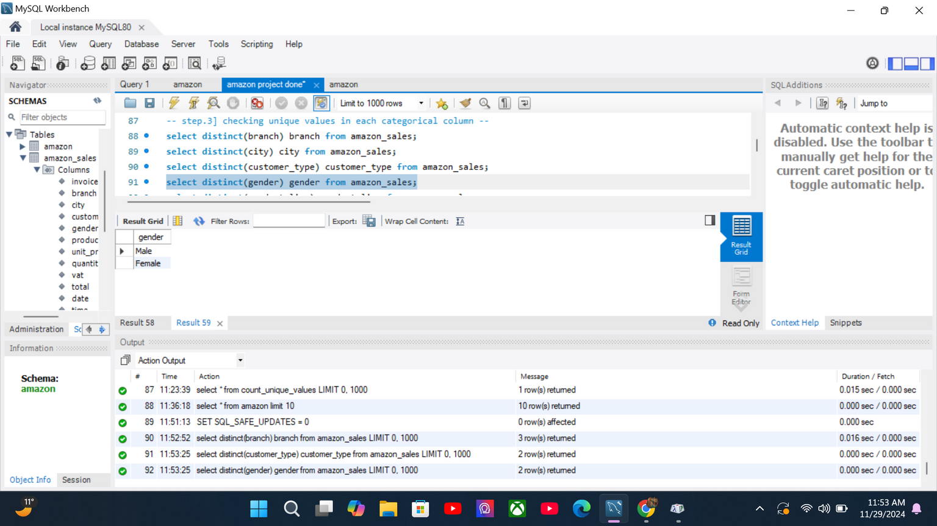

SOME OF THE UNIQUE VALUE

Slide 11
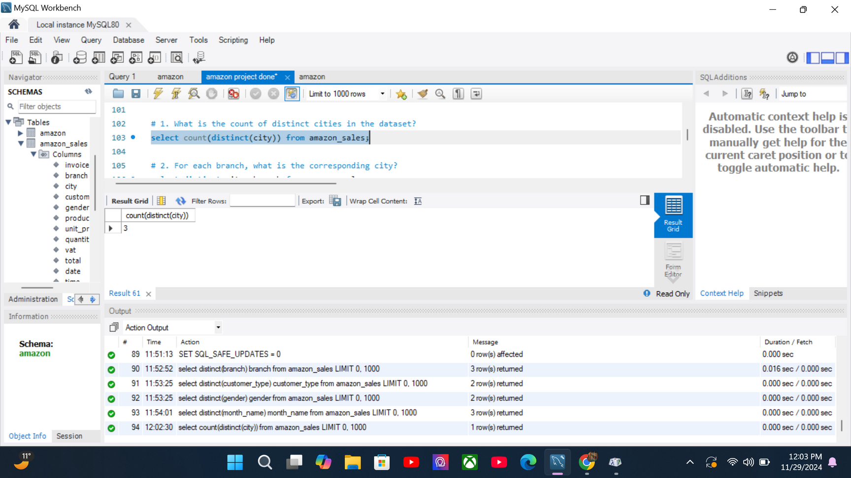
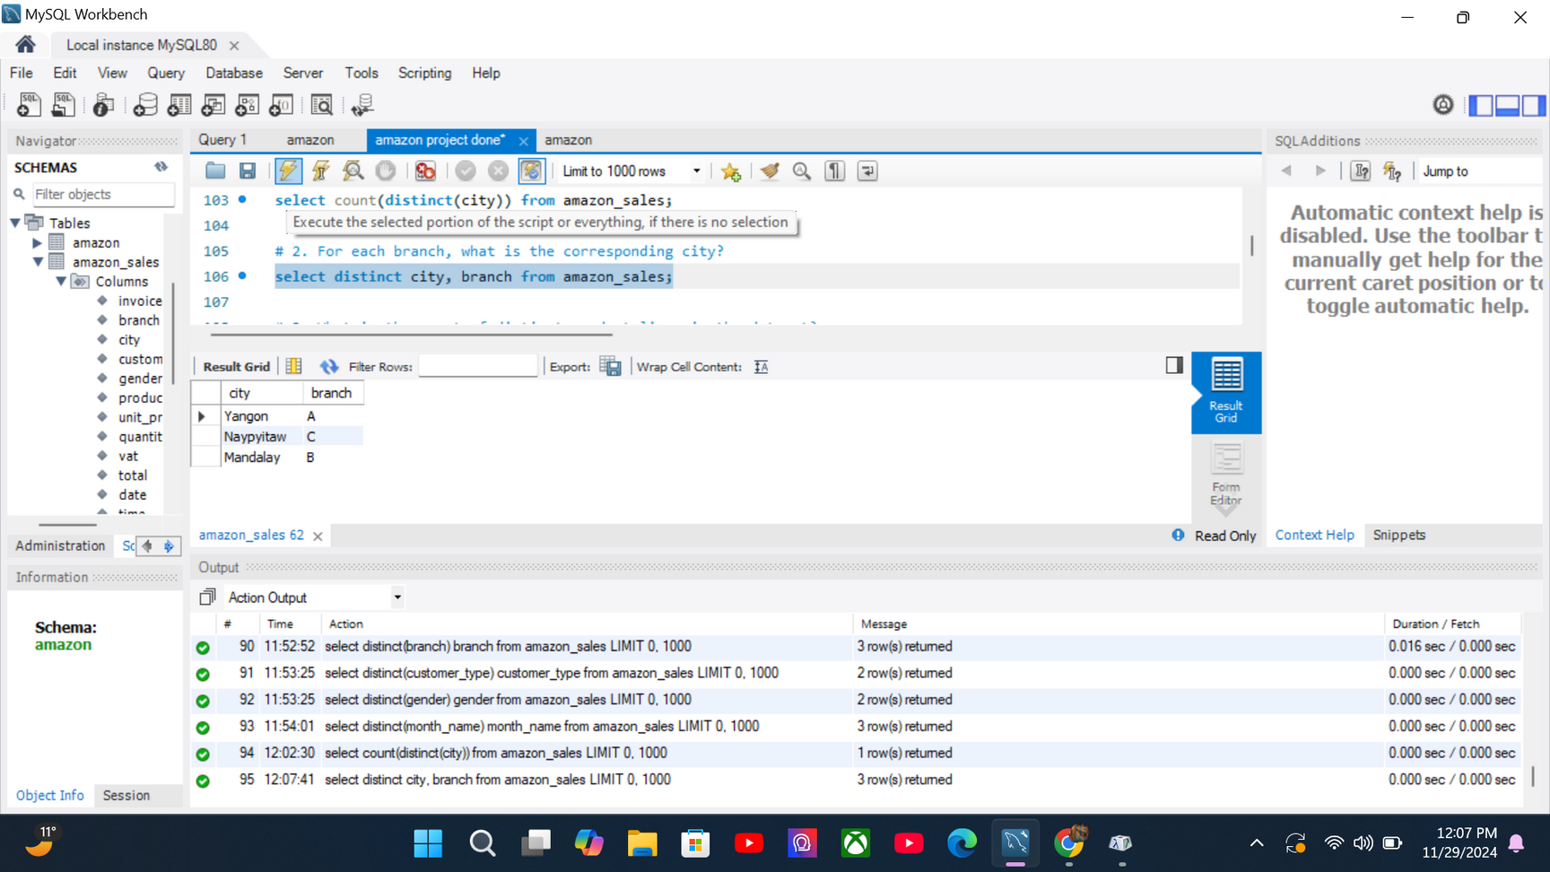
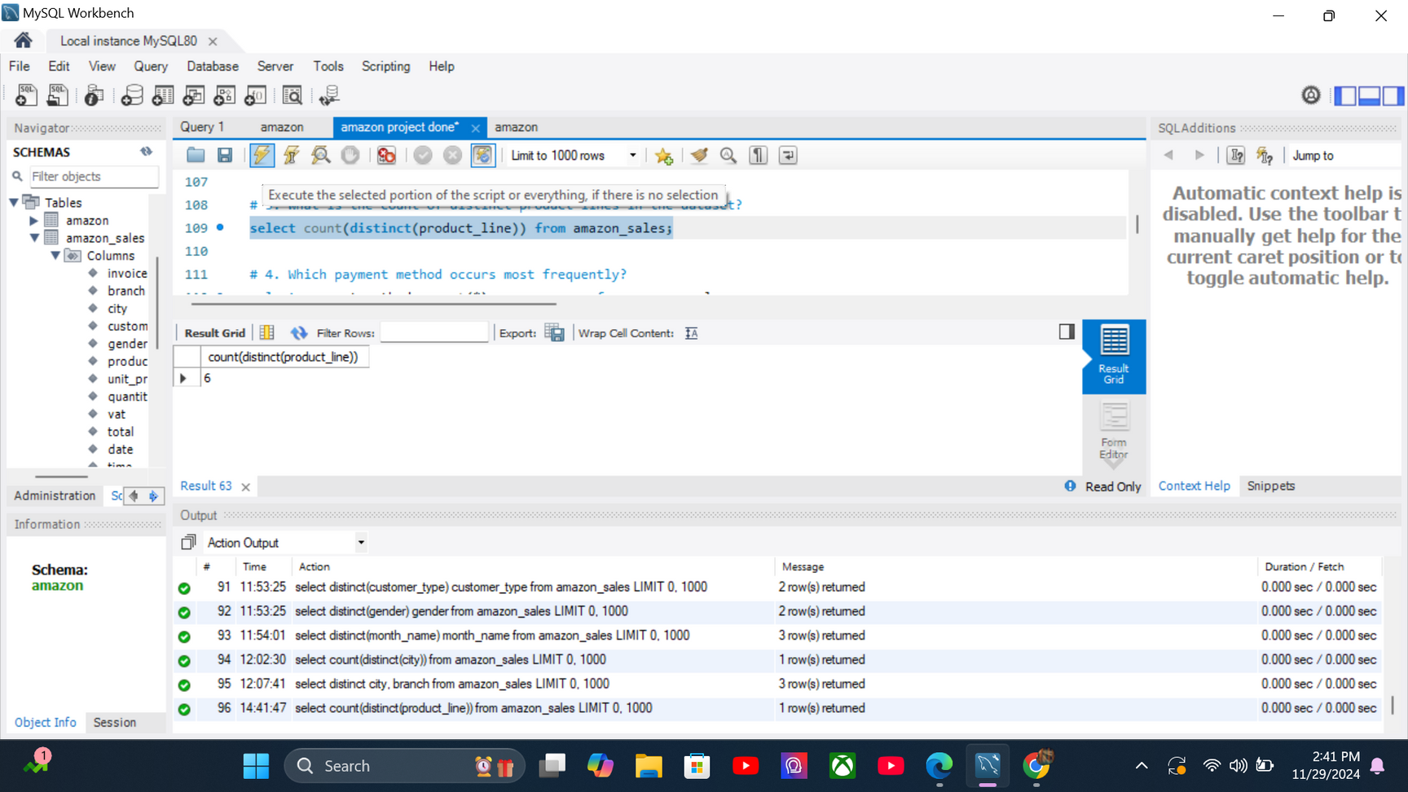
BUSINESS QUESTIONS
# 1. WHAT IS THE COUNT OF DISTINCT CITIES IN THE DATASET?
select count(distinct(city)) from amazon_sales;
# 2. FOR EACH BRANCH, WHAT IS THE CORRESPONDING CITY?
select distinct city, branch from amazon_sales;
# 3. WHAT IS THE COUNT OF DISTINCT PRODUCT LINES IN THE DATASET?
select count(distinct(product_line)) from amazon_sales;

Slide 12

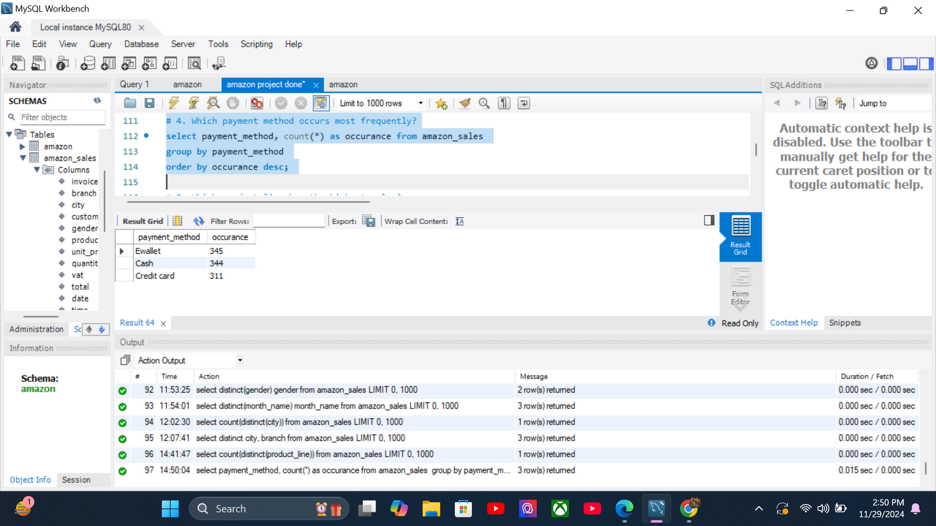
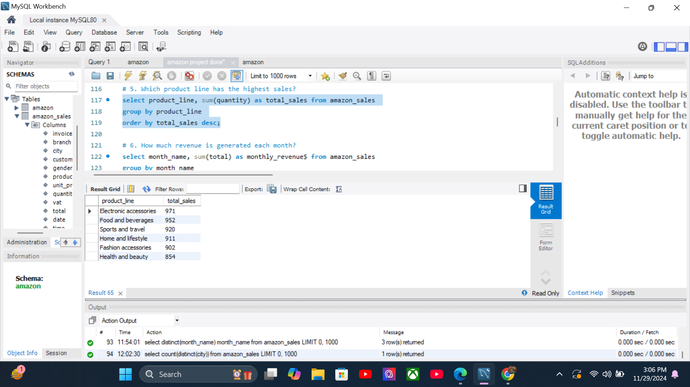
# 4. WHICH PAYMENT METHOD OCCURS MOST FREQUENTLY?
select payment_method, count(*) as occurance from amazon_sales
group by payment_method
order by occurance desc;
# 5. WHICH PRODUCT LINE HAS THE HIGHEST SALES?
select product_line, sum(quantity) as total_sales from amazon_sales
group by product_line
order by total_sales desc;

Slide 13
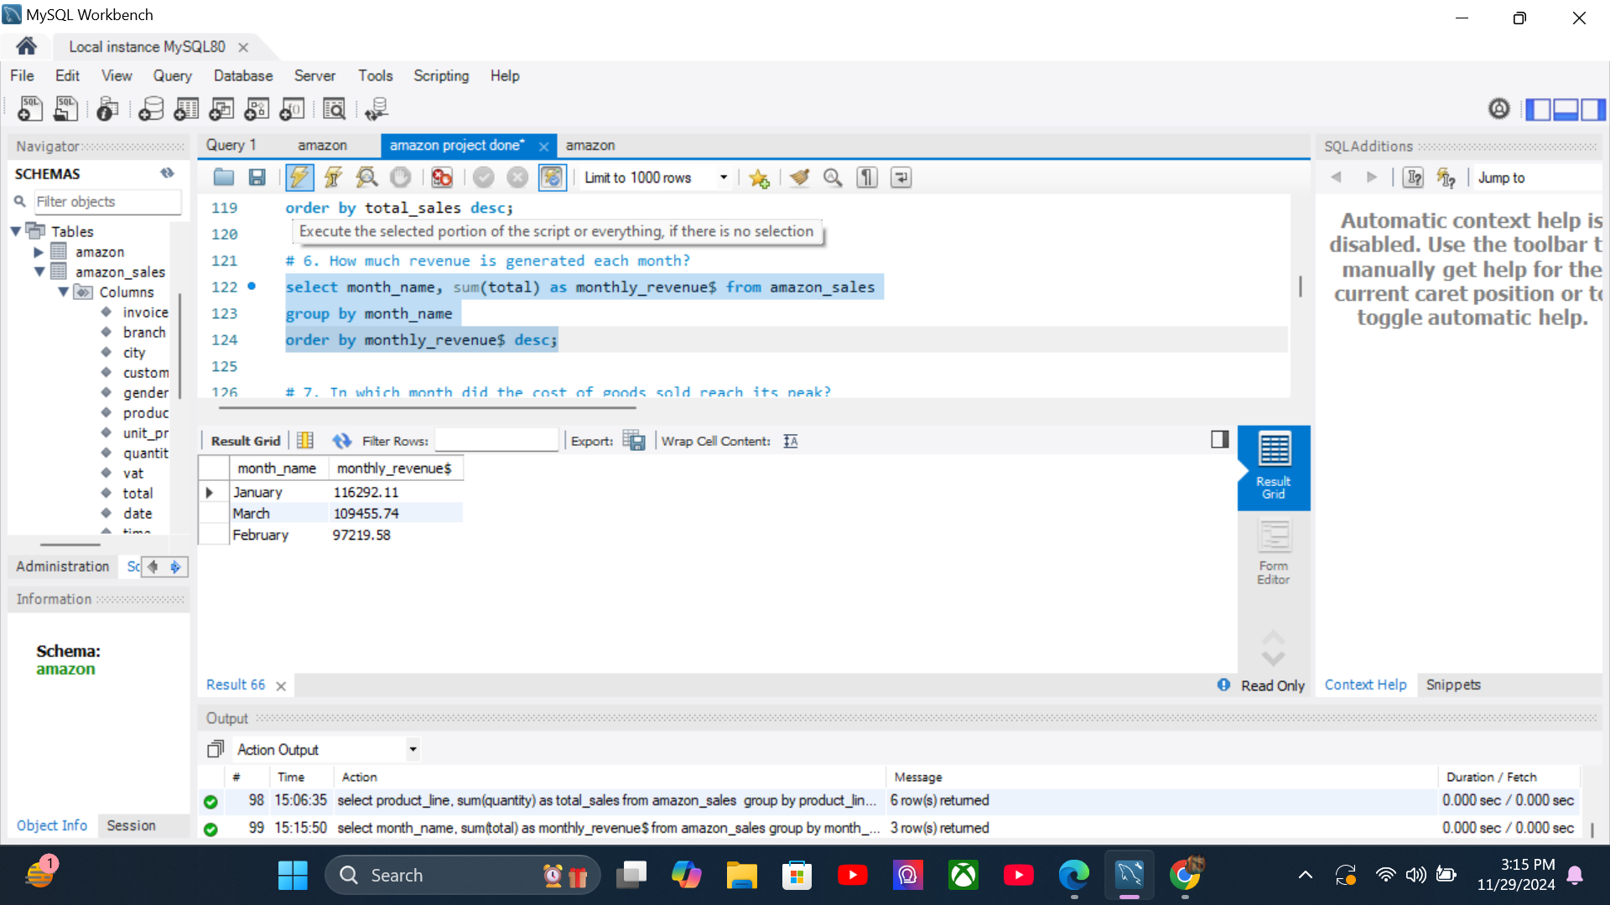
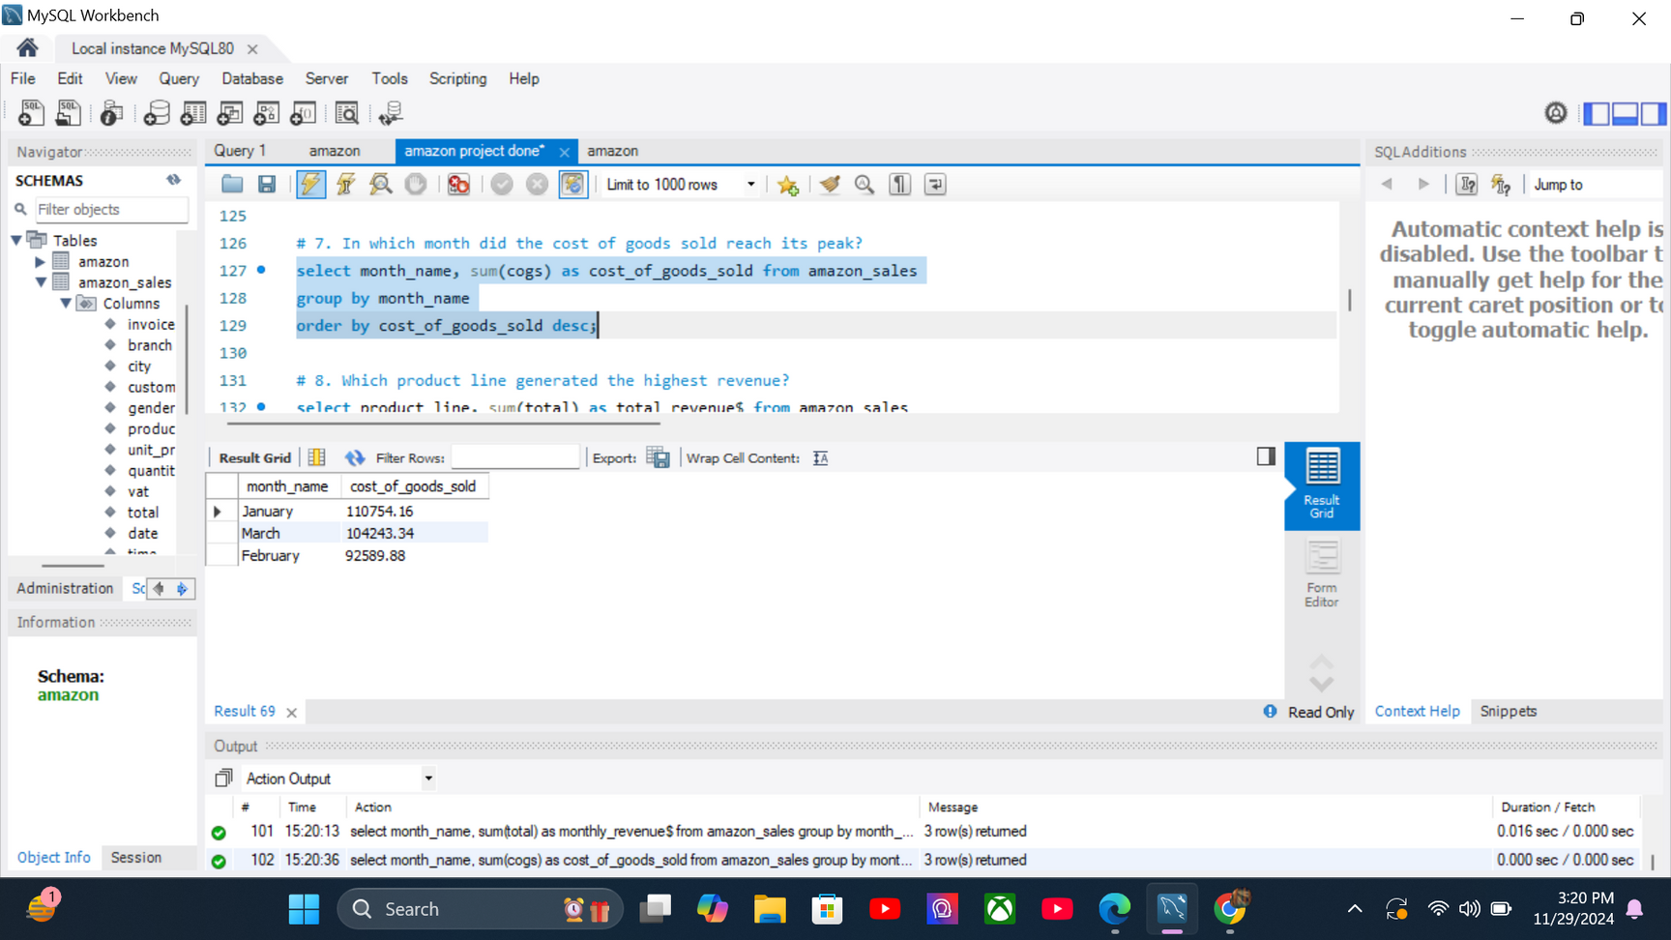
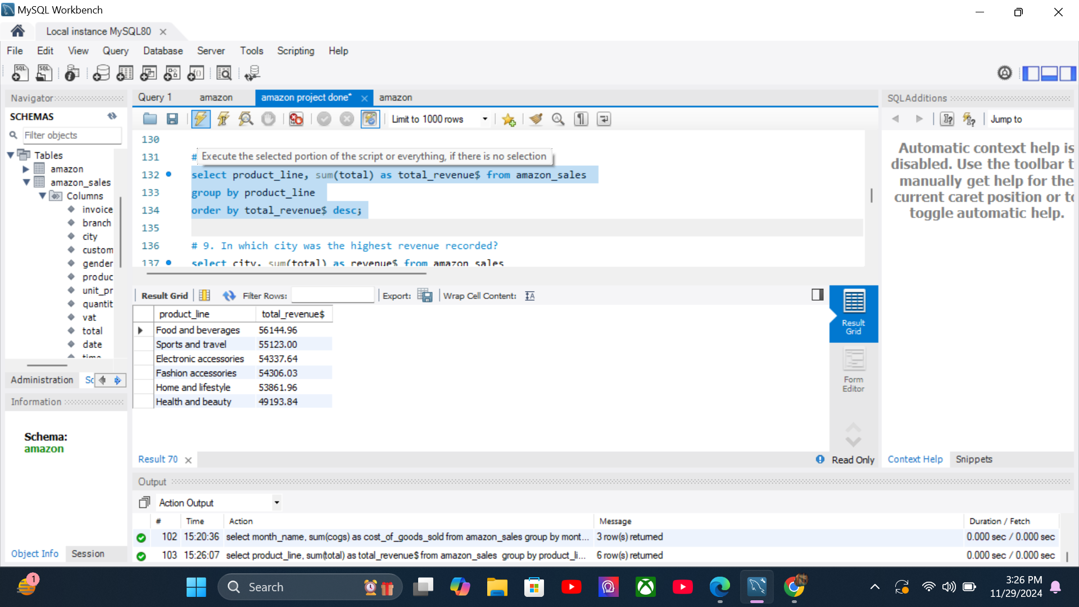
# 6. How much revenue is generated each month?
select month_name, sum(total) as monthly_revenue$ from amazon_sales
group by month_name
order by monthly_revenue$ desc;
# 7. In which month did the cost of goods sold reach its peak?
select month_name, sum(cogs) as cost_of_goods_sold from amazon_sales
group by month_name
order by cost_of_goods_sold desc;
# 8. Which product line generated the highest revenue?
select product_line, sum(total) as total_revenue$ from amazon_sales
group by product_line
order by total_revenue$ desc;

Slide 14
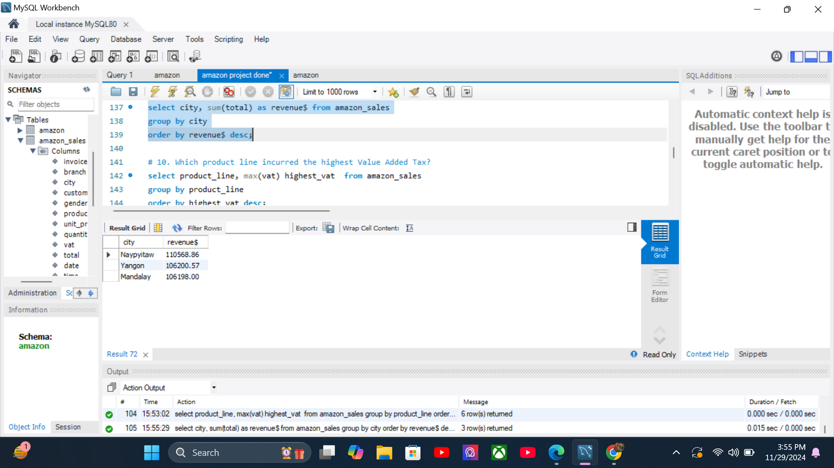
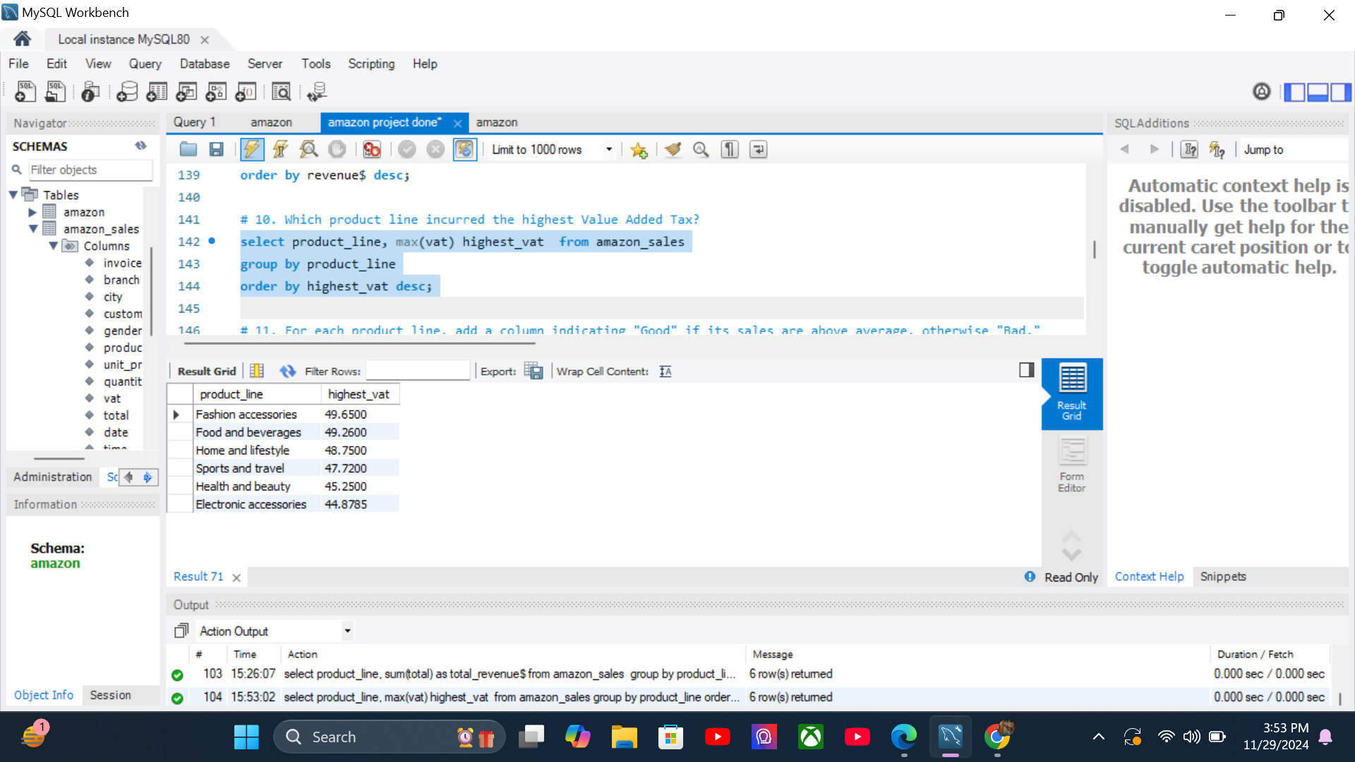
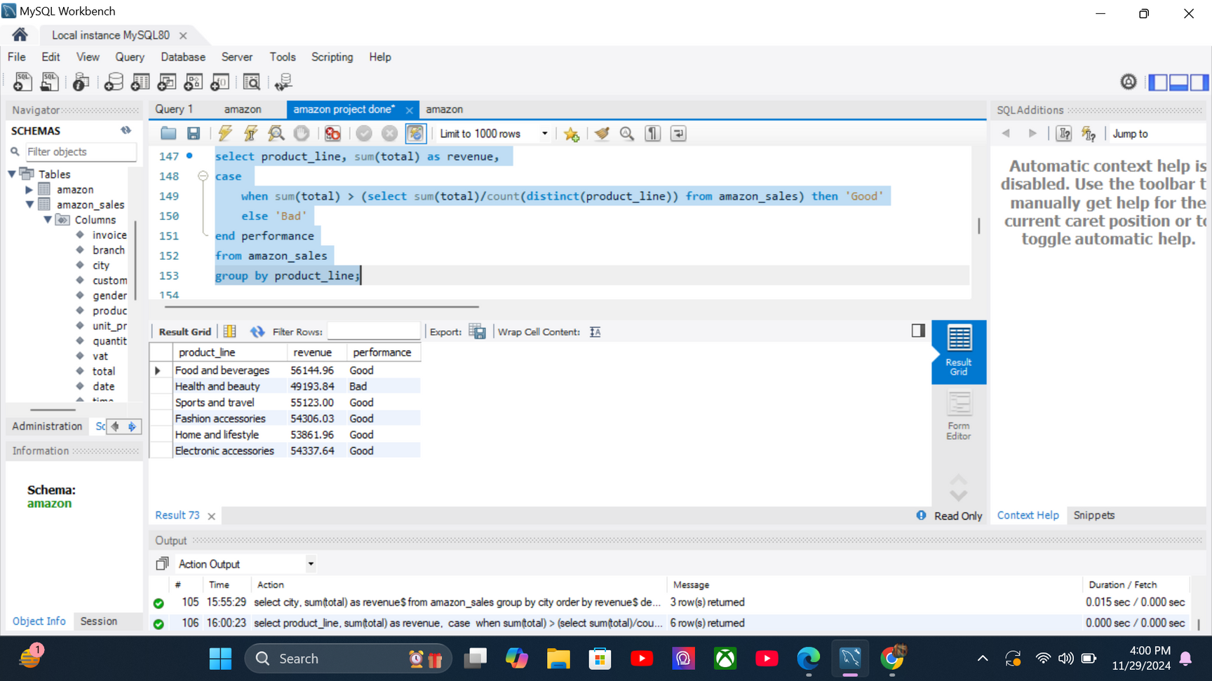
# 9. In which city was the highest revenue recorded?
select city, sum(total) as revenue$ from amazon_sales
group by city
order by revenue$ desc;
# 10. Which product line incurred the highest Value Added Tax?
select product_line, max(vat) highest_vat from amazon_sales
group by product_line
order by highest_vat desc;
# 11. For each product line, add a column indicating "Good" if its sales are above average, otherwise "Bad."
select product_line, sum(total) as revenue,
case
when sum(total) > (select sum(total)/count(distinct(product_line)) from amazon_sales) then 'Good'
else 'Bad'
end performance
from amazon_sales
group by product_line;

Slide 15
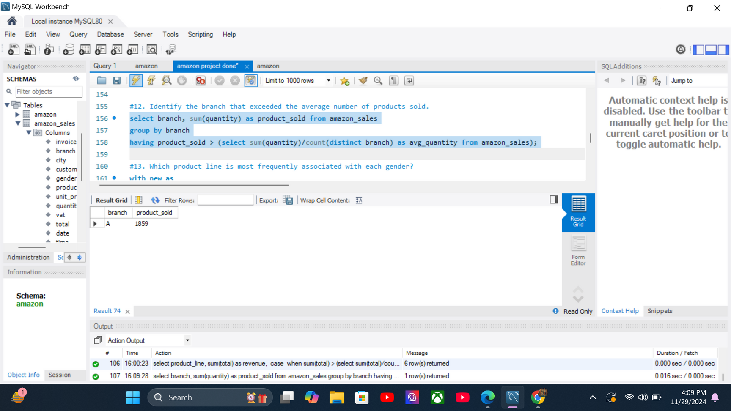
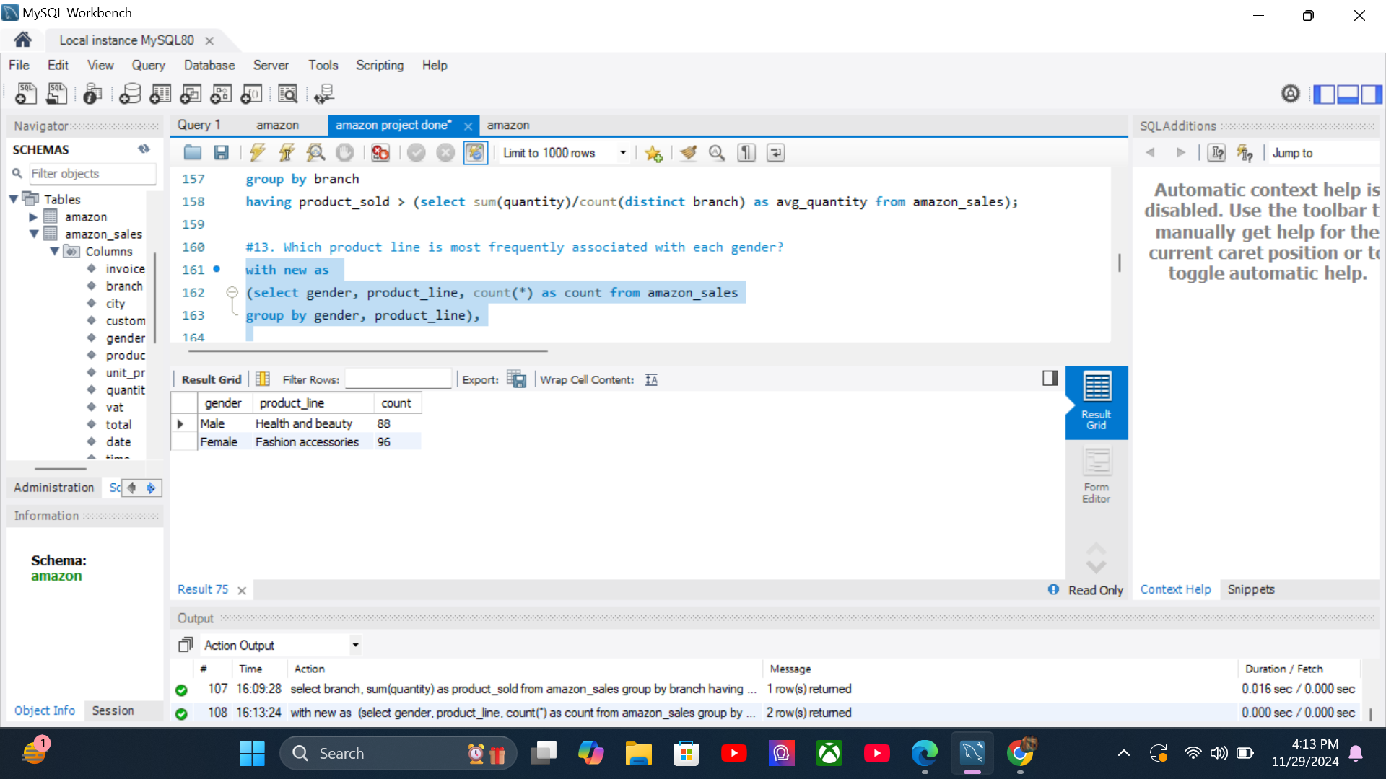
#12. Identify the branch that exceeded the average number of products sold.
select branch, sum(quantity) as product_sold from amazon_sales
group by branch
having product_sold > (select sum(quantity)/count(distinct branch) as avg_quantity from amazon_sales);
#13. Which product line is most frequently associated with each gender?
with new as
(select gender, product_line, count(*) as count from amazon_sales
group by gender, product_line),
max_count as
(select max(count) from new group by gender)
select * from new
where count in (select * from max_count) limit 2;
text

Slide 16
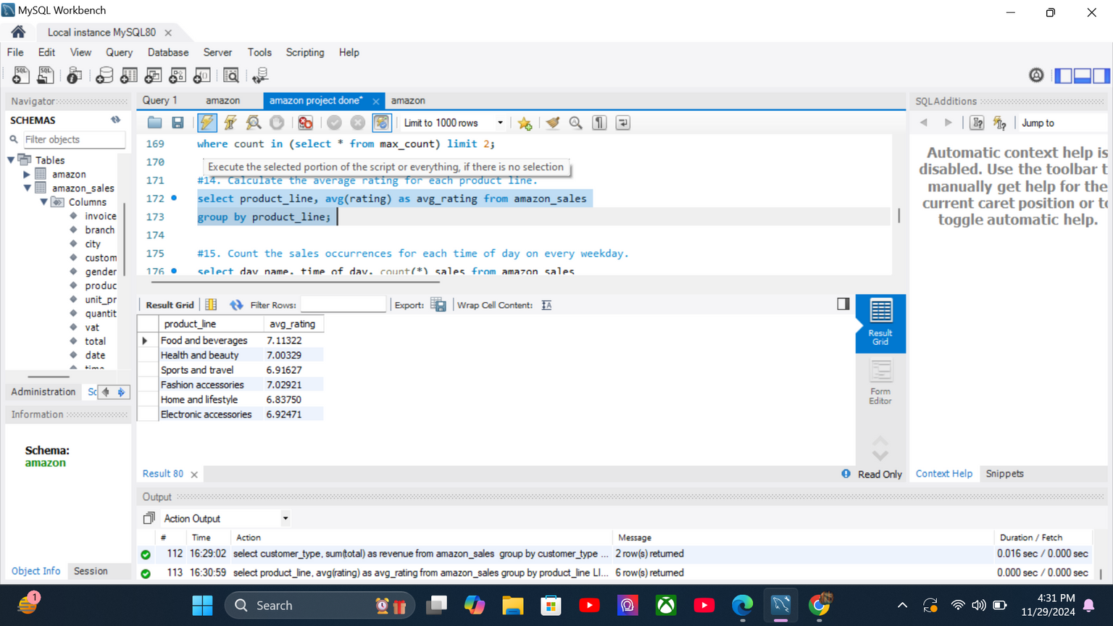
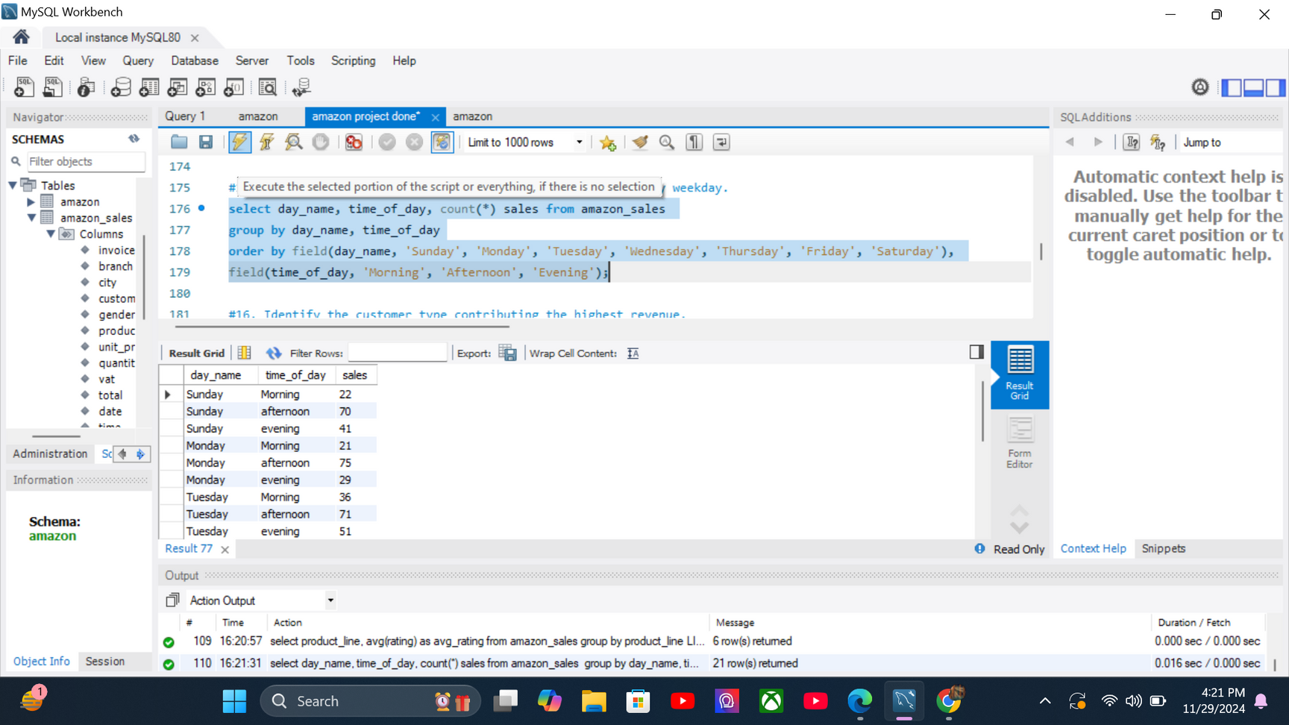
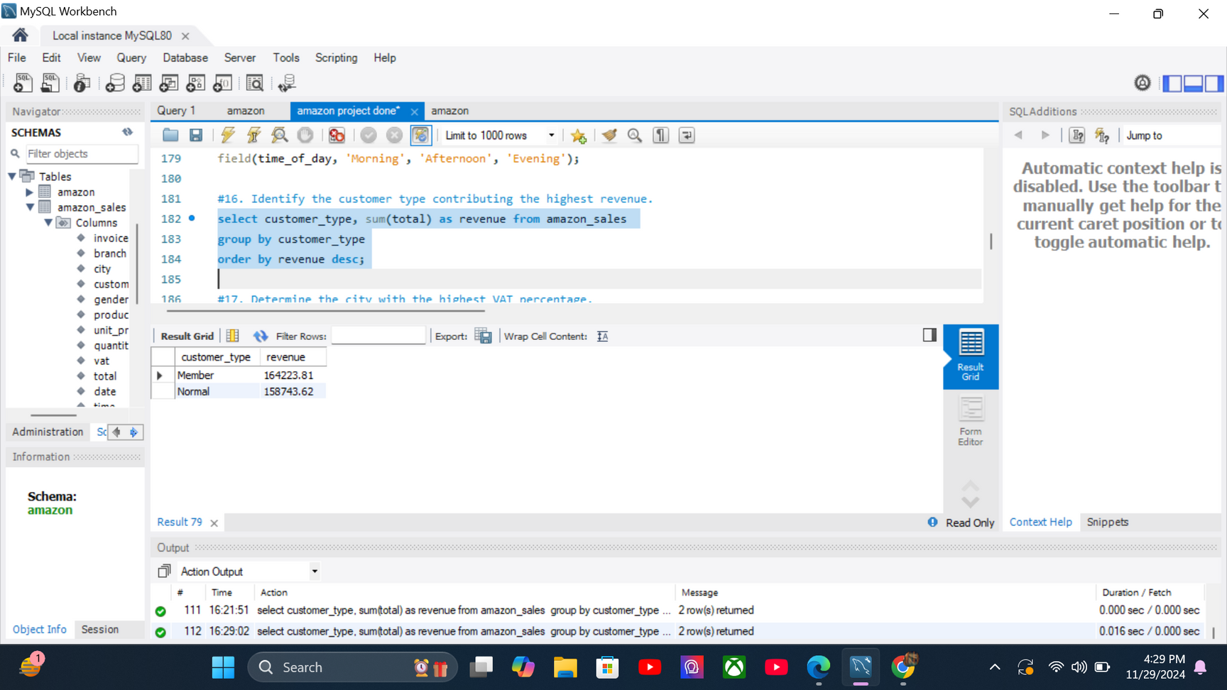
#14. CALCULATE THE AVERAGE RATING FOR EACH PRODUCT LINE.
select product_line, avg(rating) as avg_rating from amazon_sales
group by product_line;
#15. Count the sales occurrences for each time of day on every weekday.
select day_name, time_of_day, count(*) sales from amazon_sales
group by day_name, time_of_day
order by field(day_name, 'Sunday', 'Monday', 'Tuesday', 'Wednesday', 'Thursday', 'Friday', 'Saturday'),
field(time_of_day, 'Morning', 'Afternoon', 'Evening');
#16. Identify the customer type contributing the highest revenue.
select customer_type, sum(total) as revenue from amazon_sales
group by customer_type
order by revenue desc;

Slide 17

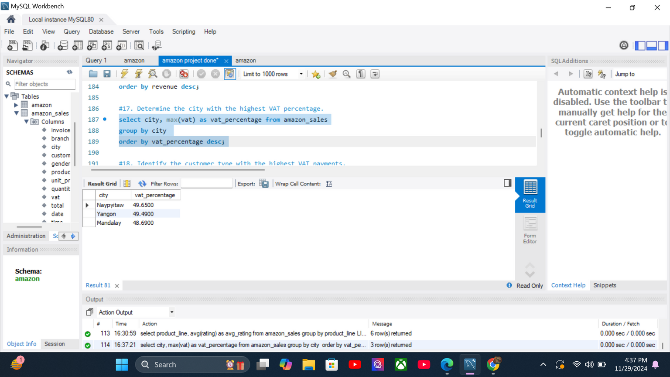
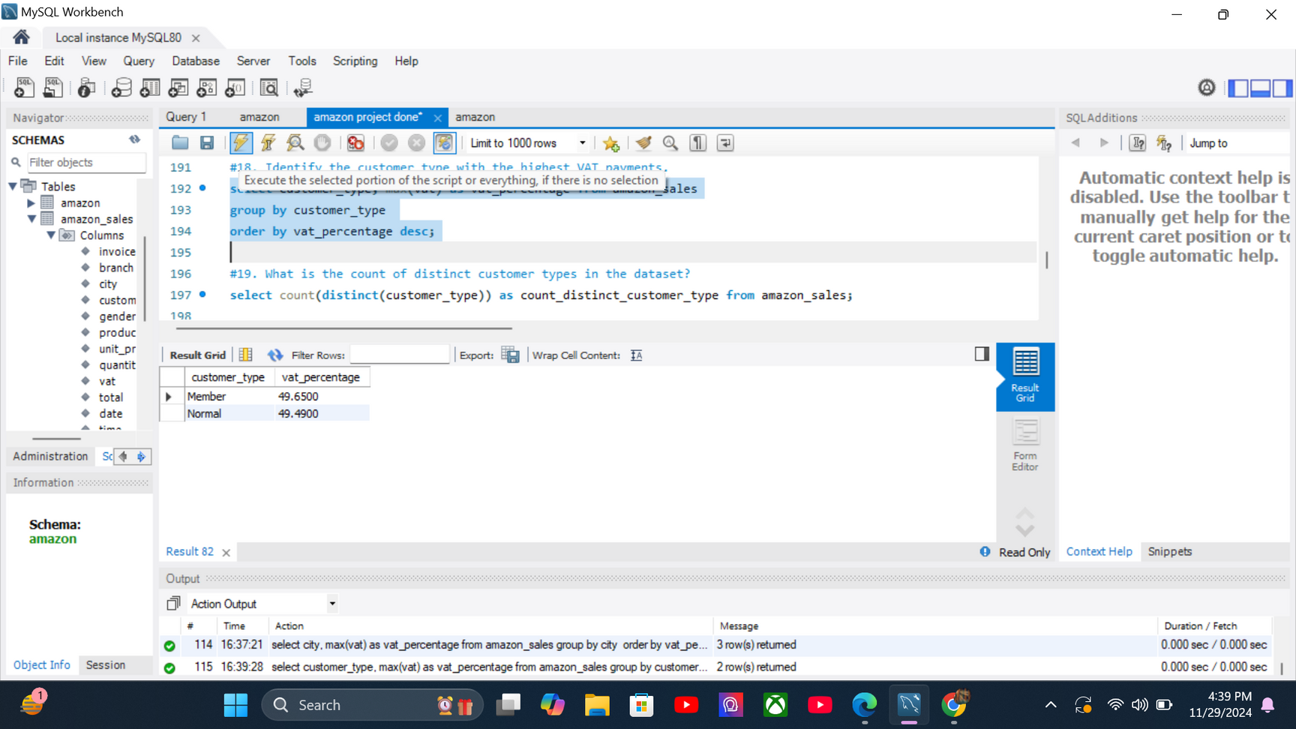
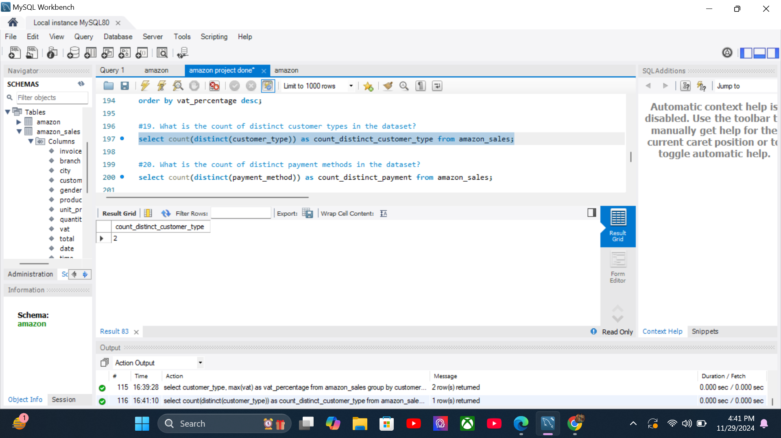
#17. DETERMINE THE CITY WITH THE HIGHEST VAT PERCENTAGE.
select city, max(vat) as vat_percentage from amazon_sales
group by city
order by vat_percentage desc;
#18. Identify the customer type with the highest VAT payments.
select customer_type, max(vat) as vat_percentage from amazon_sales
group by customer_type
order by vat_percentage desc;
#19. What is the count of distinct customer types in the dataset?
select count(distinct(customer_type)) as count_distinct_customer_type from amazon_sales;

Slide 18
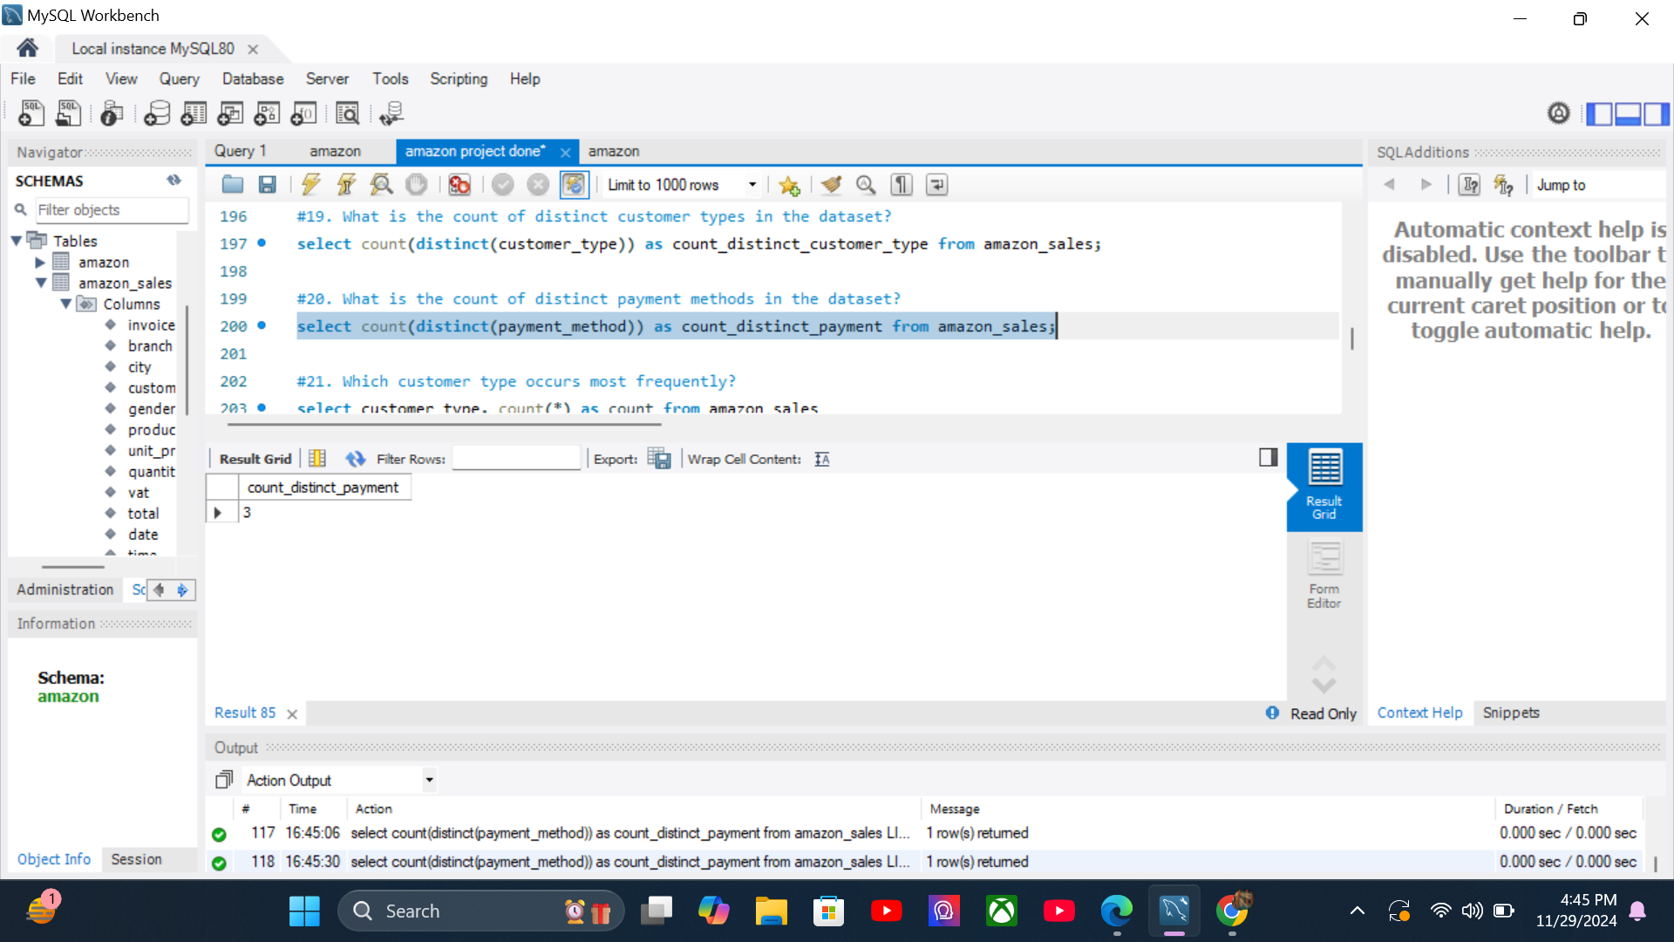
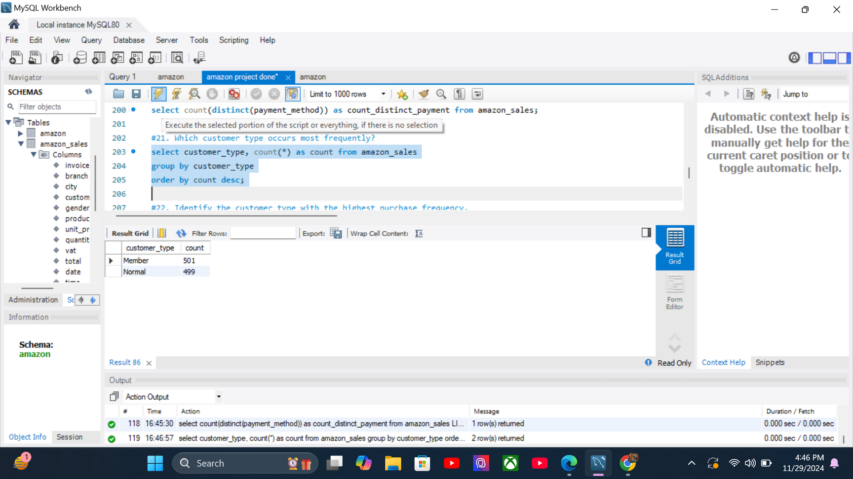
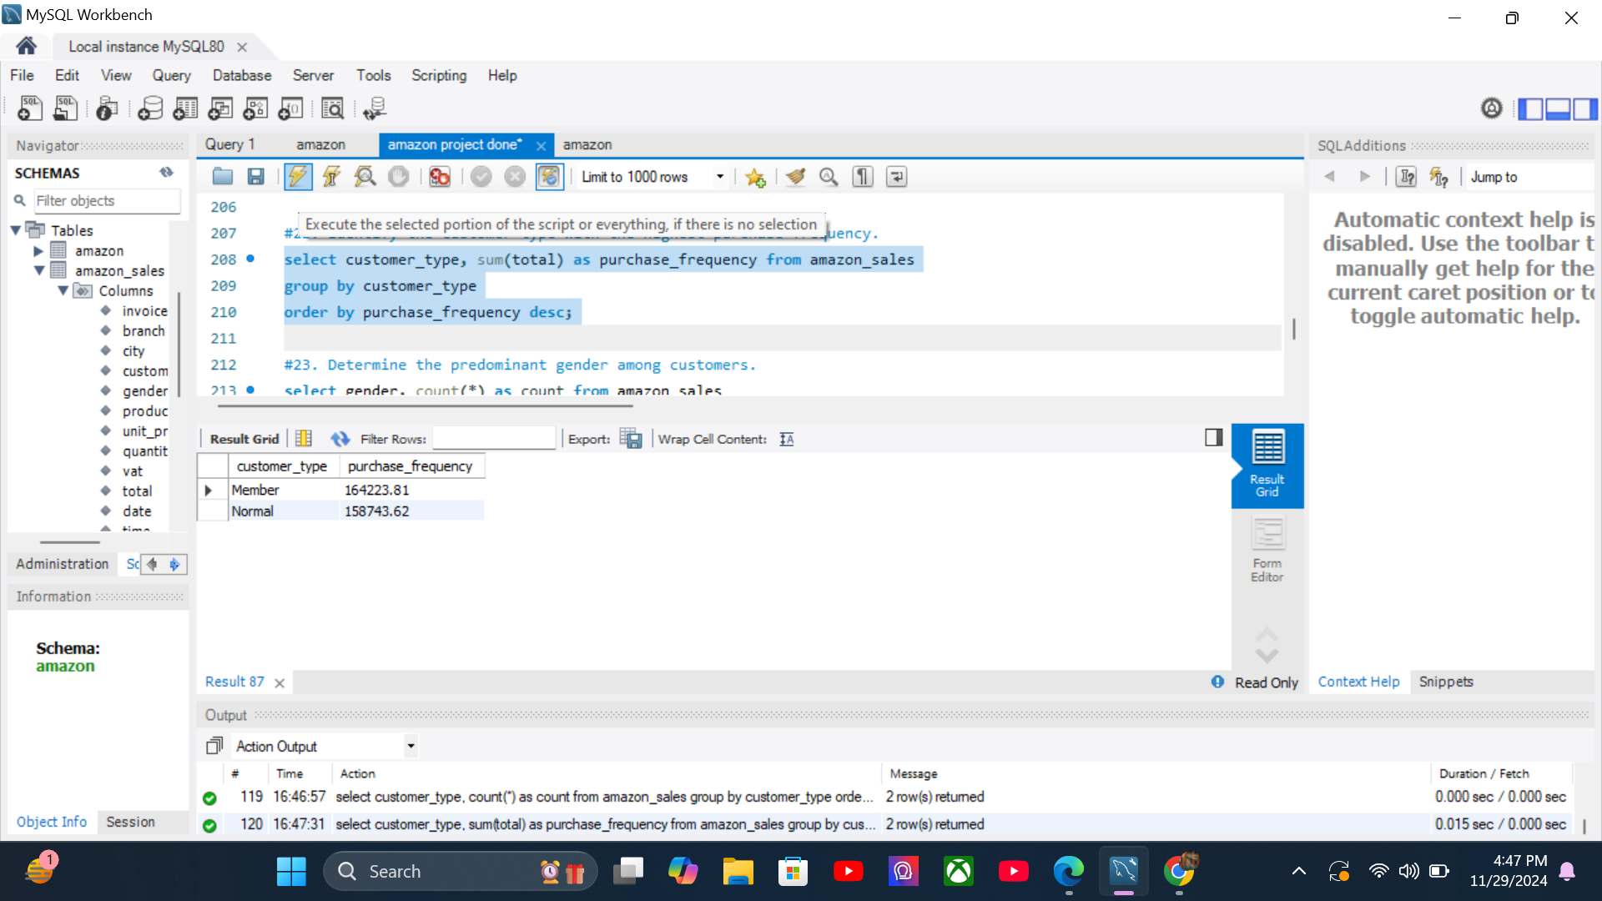
#20. What is the count of distinct payment methods in the dataset?
select count(distinct(payment_method)) as count_distinct_payment from amazon_sales;
#21. Which customer type occurs most frequently?
select customer_type, count(*) as count from amazon_sales
group by customer_type
order by count desc;
#22. Identify the customer type with the highest purchase frequency.
select customer_type, sum(total) as purchase_frequency from amazon_sales
group by customer_type
order by purchase_frequency desc;
07

Slide 19
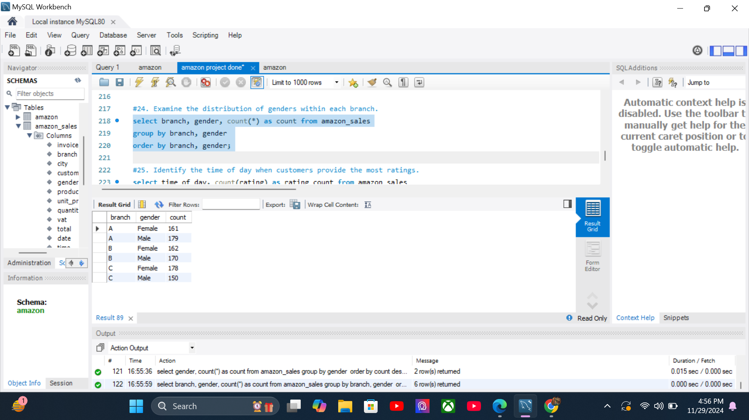

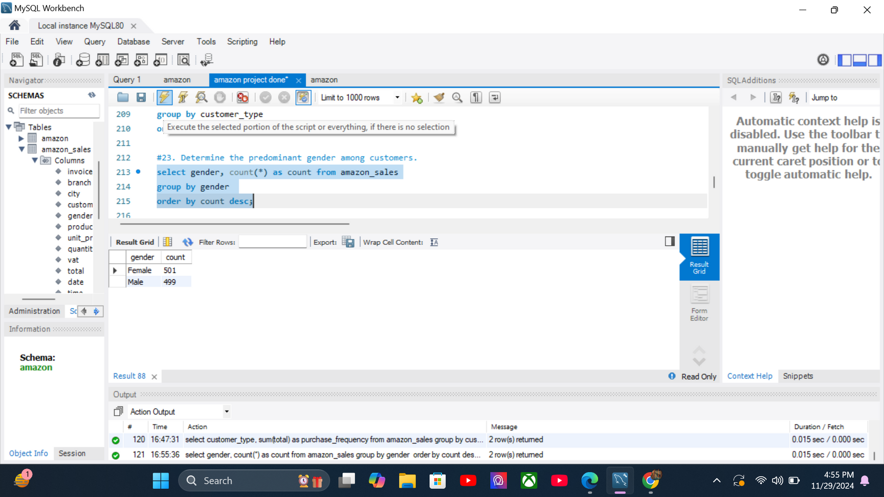
#23. DETERMINE THE PREDOMINANT GENDER AMONG CUSTOMERS.
SELECT GENDER, COUNT(*) AS COUNT FROM AMAZON_SALES
GROUP BY GENDER
ORDER BY COUNT DESC;
#24. EXAMINE THE DISTRIBUTION OF GENDERS WITHIN EACH BRANCH.
SELECT BRANCH, GENDER, COUNT(*) AS COUNT FROM AMAZON_SALES
GROUP BY BRANCH, GENDER
ORDER BY BRANCH, GENDER;
#25. IDENTIFY THE TIME OF DAY WHEN CUSTOMERS PROVIDE THE MOST RATINGS.
SELECT TIME_OF_DAY, COUNT(RATING) AS RATING_COUNT FROM AMAZON_SALES
GROUP BY TIME_OF_DAY
ORDER BY RATING_COUNT DESC;

Slide 20
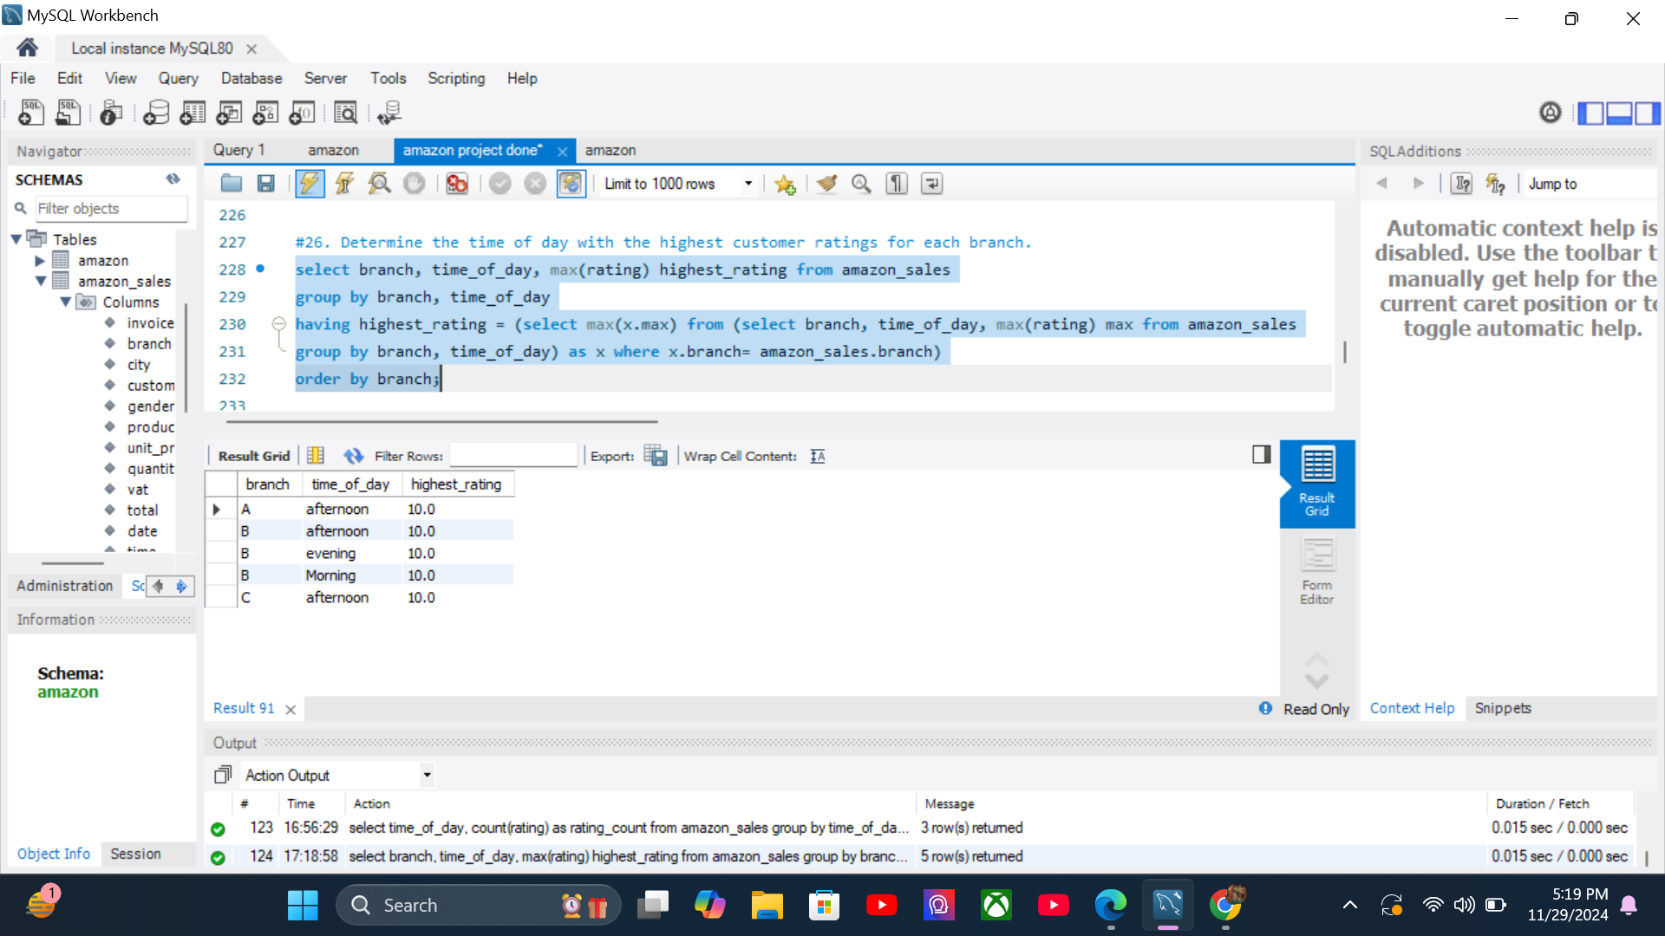
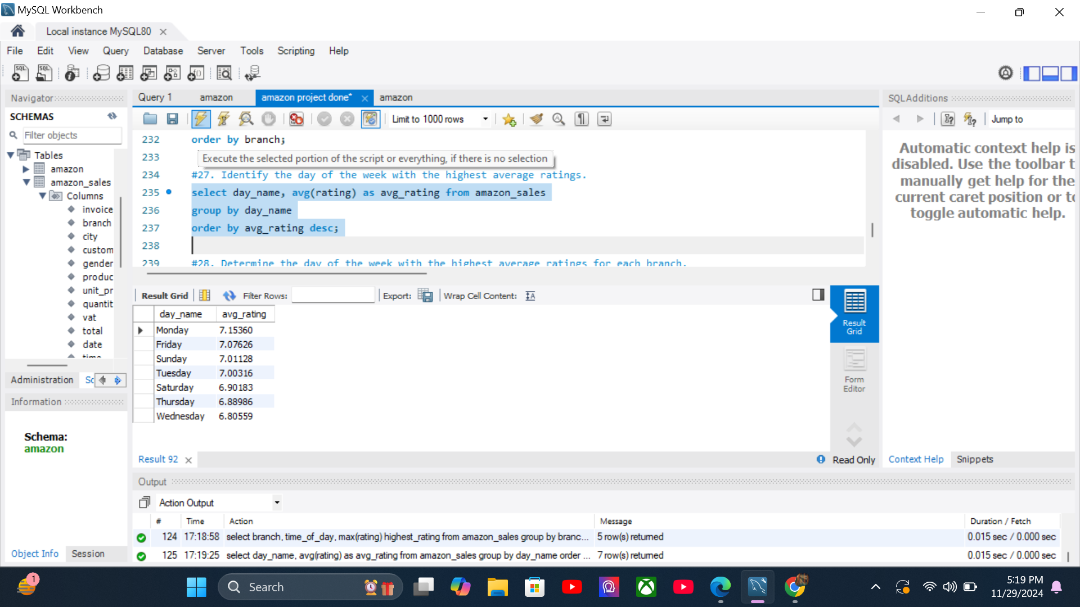
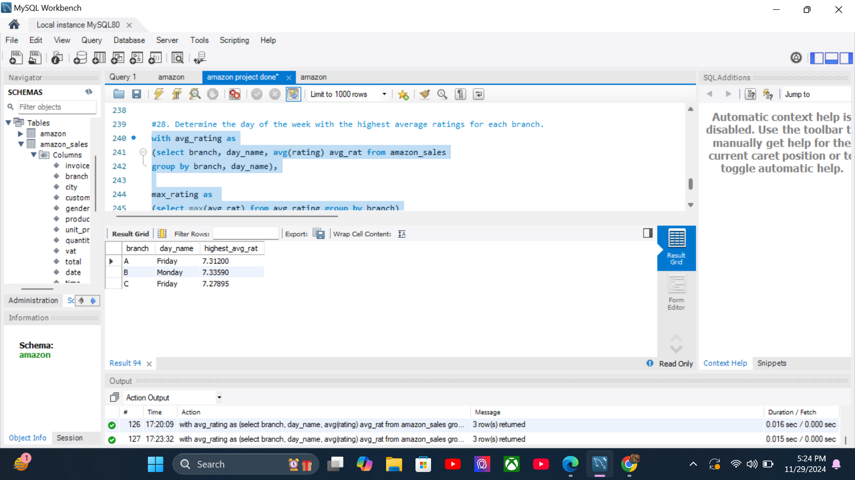
#26. DETERMINE THE TIME OF DAY WITH THE HIGHEST CUSTOMER RATINGS FOR EACH BRANCH.
select branch, time_of_day, max(rating) highest_rating from amazon_sales
group by branch, time_of_day
having highest_rating = (select max(x.max) from (select branch, time_of_day, max(rating) max from amazon_sales
group by branch, time_of_day) as x where x.branch= amazon_sales.branch)
order by branch;
#27. Identify the day of the week with the highest average ratings.
select day_name, avg(rating) as avg_rating from amazon_sales
group by day_name
order by avg_rating desc;
#28. Determine the day of the week with the highest average ratings for each branch.
with avg_rating as
(select branch, day_name, avg(rating) avg_rat from amazon_sales
group by branch, day_name),T

Slide 21
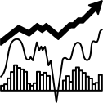
INSIGHTS
CUSTOMER ANALYSIS
Highest Revenue Gender: Female ($ 167883.26)
Highest Revenue Customer Type: Member ($ 164223.81)
Distribution Of Members Based On Gender: Male(240) Female(261)

Slide 22
PRODUCT ANALYSIS
Highest Sales Product Line: Electronic Accessories (Units Sold:971)
Highest Revenue Product Line: Food and Beverages ($ 56144.96)
Lowest Sales Product Line: Health and Beauty (Unit Sold: 854)
Lowest Revenue Product Line: Health and Beauty ($ 49193.84)

Slide 23
SALES ANALYSIS
Month With Highest Revenue: January ($ 116292.11)
City & Branch With Highest Revenue: Naypyitaw[C] ($ 110568.86)
Month With Lowest Revenue: February ($ 97219.58)
City & Branch With Lowest Revenue: Mandalay[B] ($ 106198.00)
Peak Sales Time Of Day: Afternoon
Peak Sales Day Of Week: Saturday

Slide 24

THANK YOU!
Thank you for your attention to our sales report presentation.

